Slide 1

Az National Trucking Data Analysis
MIS 6346.501 - Big Data
By Group 9: Rucha Jadav
Utkarsha Chandgadkar
Vinay Chillakuru
Akshar Gabani
Mounika Kalakonda
Maanas Dogga

Slide 2






Data Workflow

Slide 3
Dataset Explained
Important Columns For Analysis:
Riskfactor, Location, Truck model, Events, Location, Idling, Velocity, Driver ID
Trucks
Geolocation
Narrative:
What other variables affect the risk factor
Models
Location
False telematic data
Risk Factor = events*1000000/ Total Miles
Truck_Mileage
Avg_Mileage
Risk_Factor
Driver_Mileage

Slide 4
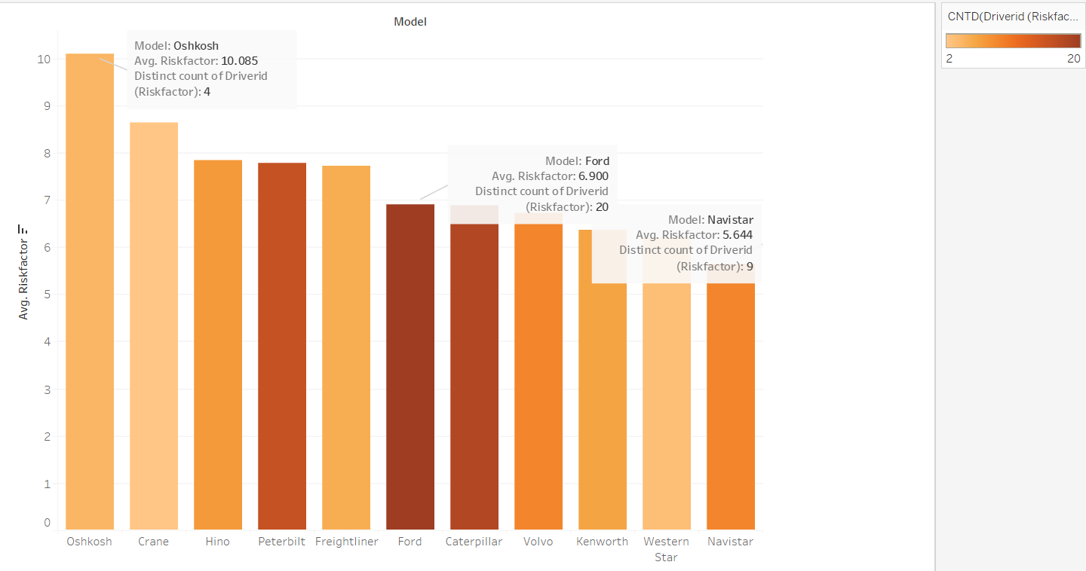
Truck Models Vs Risk Factor
The probability of having low risk factor is high with Navistar trucks
Company should recruit more drivers with Navistar trucks
Navistar trucks should be used more in high violation prone areas

Slide 5
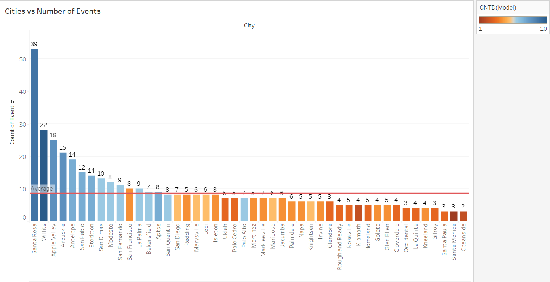
Cities vs. No. of Events
Santa Rosa issues:
9 out of 11 Truck models have violations in the city
39% of the drivers have violations in Santa Rosa
Top 5 cities that are tough to drive:
Santa Rosa, Willits, Apple Valley, Arbuckle, Antelope

Slide 6
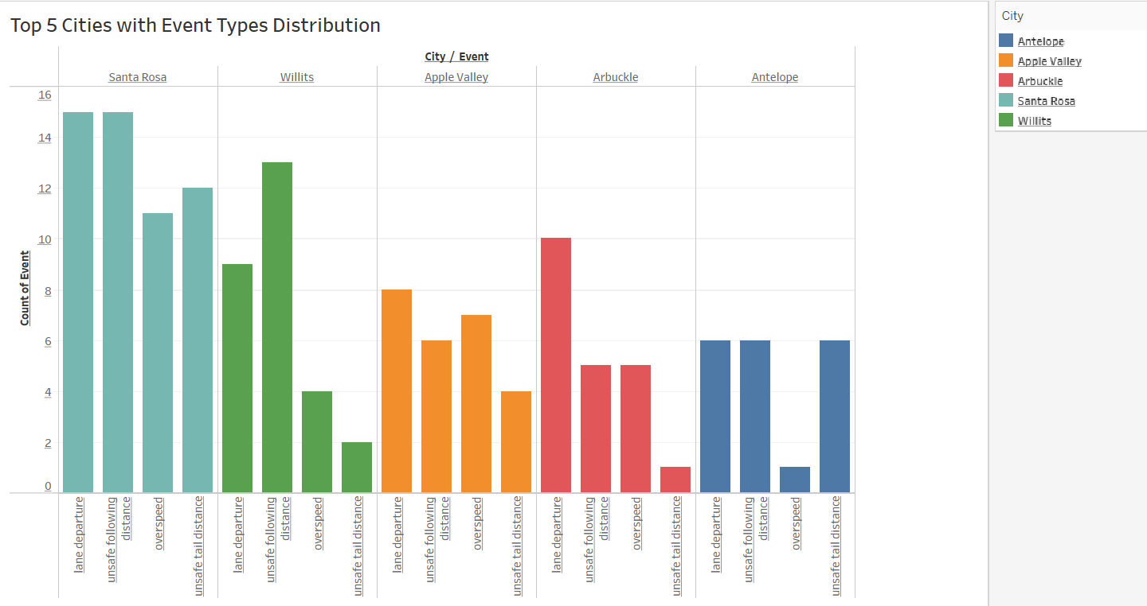
Top 5 cities & Type of Events
Lane departure and unsafe following distance are the most common
Santa Rosa Elevation change is 725m compared to 151m of Dallas which could be one of the causes behind high number of violations

Slide 7
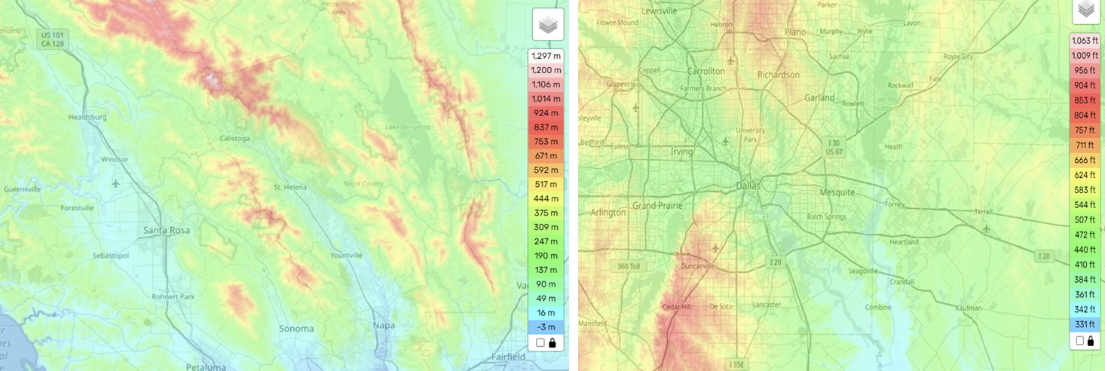


Santa Rosa vs. Dallas Elevation
Range of elevation 725m
Range of elevation 151m

Slide 8
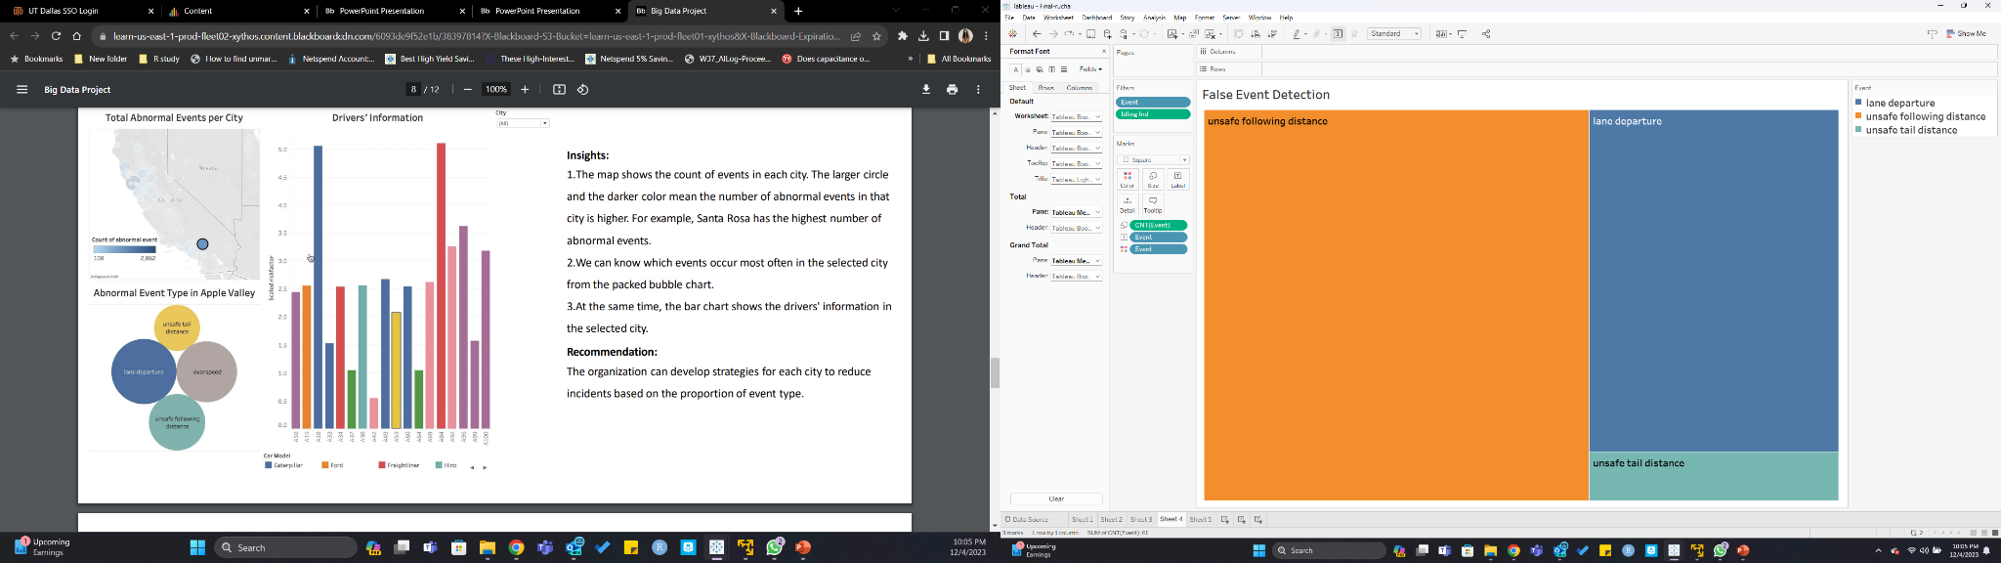
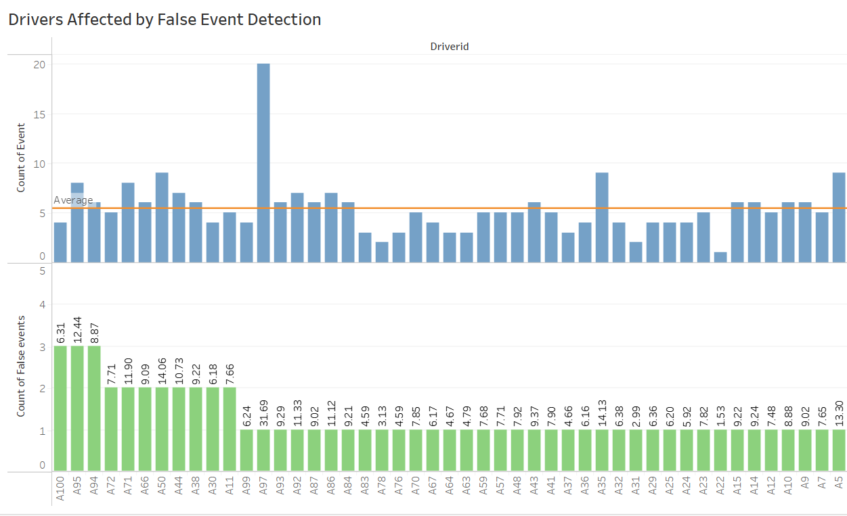
False Event Detection
Drivers Affected by False Event Detection
Telematics capturing faulty data – Notifying event for trucks with 0 velocity
Unsafe following distance has the maximum faulty event detection
Risk factor = Events*1mn / total miles
Trucks with 0 velocity being observed for violations contribute to higher risk factor of the driver
False detection of the event impacts the driver’s risk factor significantly
A100:
Total events – 4
False event detection – 3
Company should re-look at the telematics data when calculating risk factor

Slide 9
Possible Future Updates
Update risk factor equation
Add event base bias to the formula
Add terrain data to understand incidents related different geographical conditions. Basis the same we can redirect our fleet and reduce the cost of liability
Leverage lane measurements to understand related event types in detail

